Slide 1
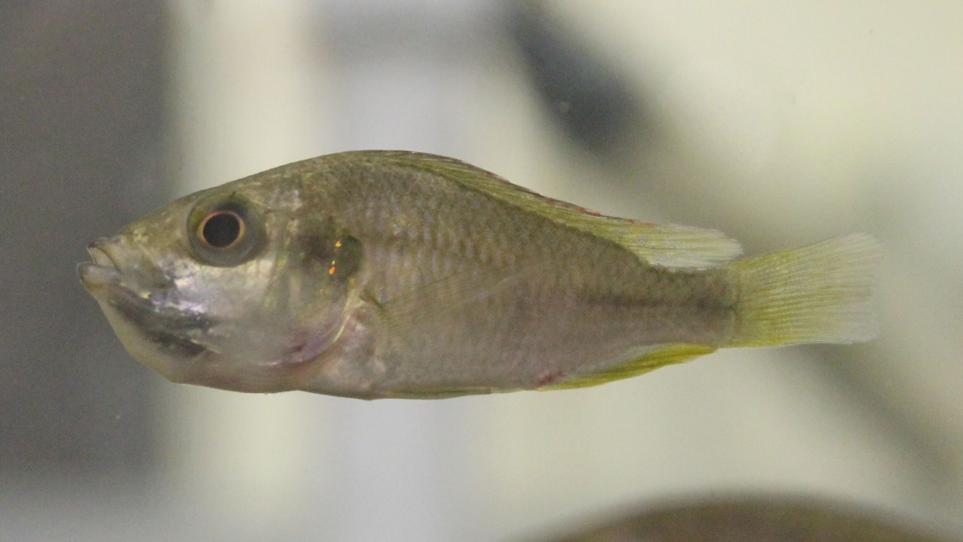
Neural mechanisms of parent-offspring recognition in a maternal mouthbrooding African cichlid fish
Emily Ray
Louisiana State University

Slide 2
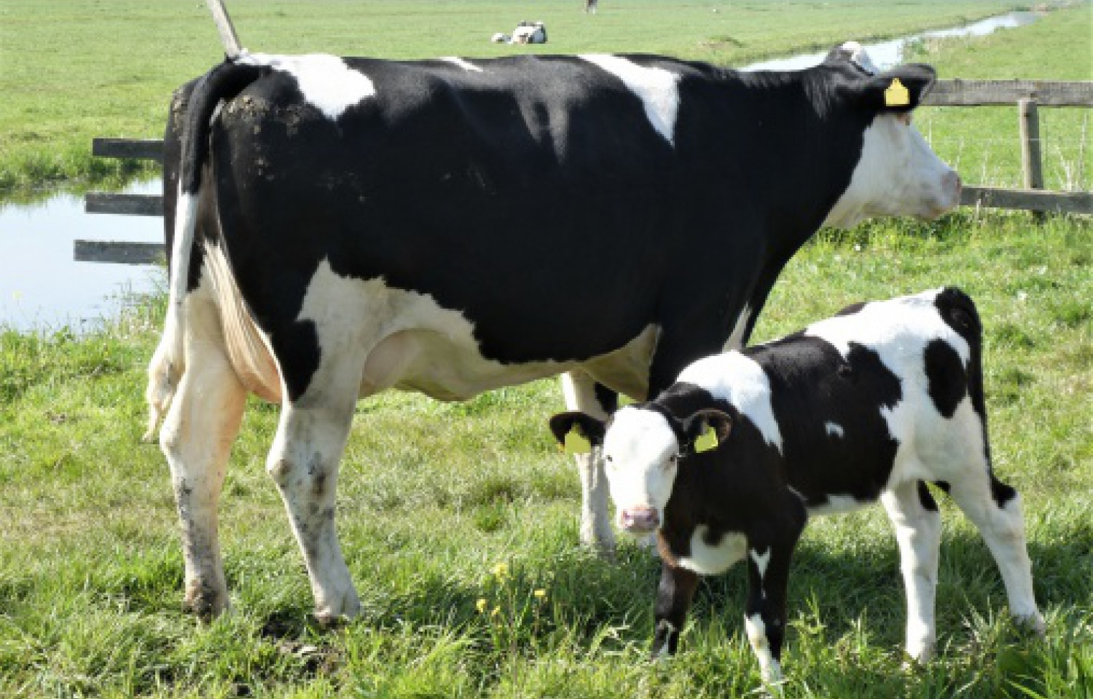
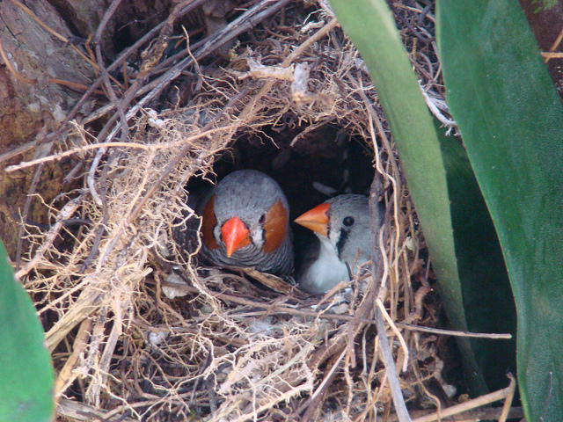
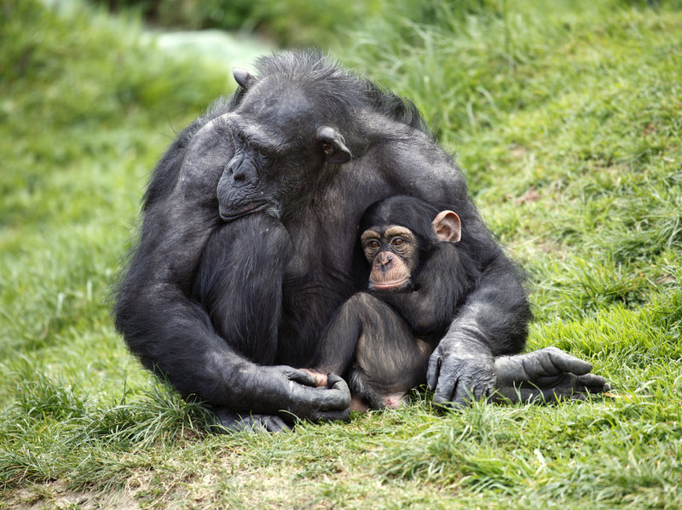
Parent-offspring recognition occurs via diverse signaling modalities
UNH
Auditory
Chemosensory
Visual
Multi-modal
Bob Vuxinic
Glen Chilton
iStockPhoto
Notes:
Parental care evolved indepently seve
Parent-offspring recognition can rely on several different signaling modalities
Cows, zebra finches, chimpanzees
Despite importance, not well studied in fishes

Slide 3
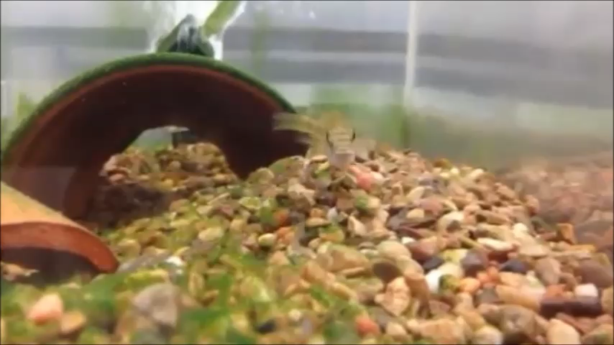
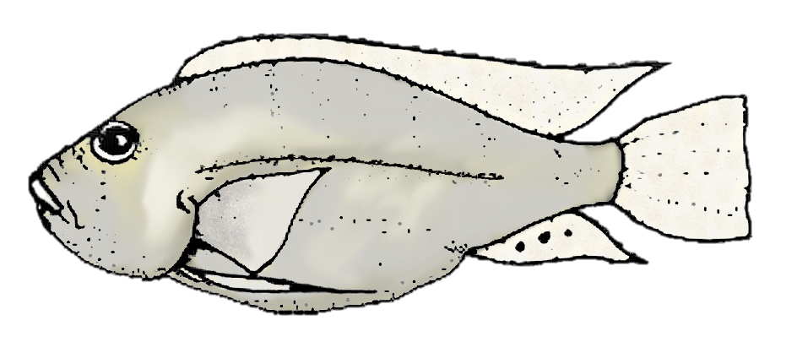
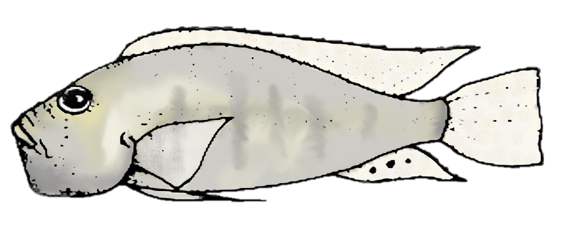
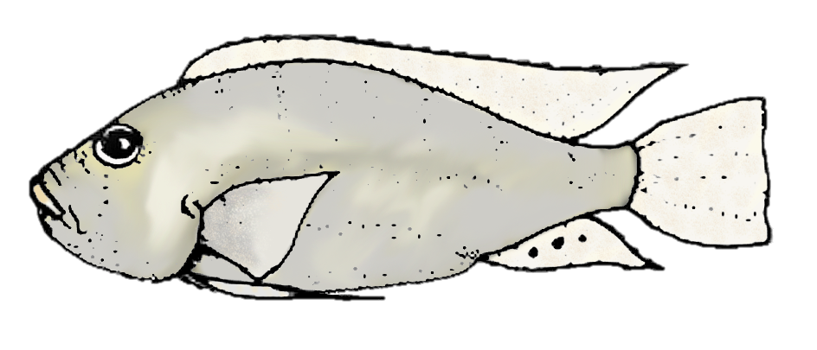
Infanticide and parental care co-exist in the maternal mouthbrooding cichlid Astatotilapia burtoni
Spawning
Brooding and Maternal Care
Gravid
Recovering
Notes:
A. burtoni females brood and provide maternal care
Adult A. burtoni cannibalize fry
POR is critical to prevent maladaptive filial cannibalism

Slide 4
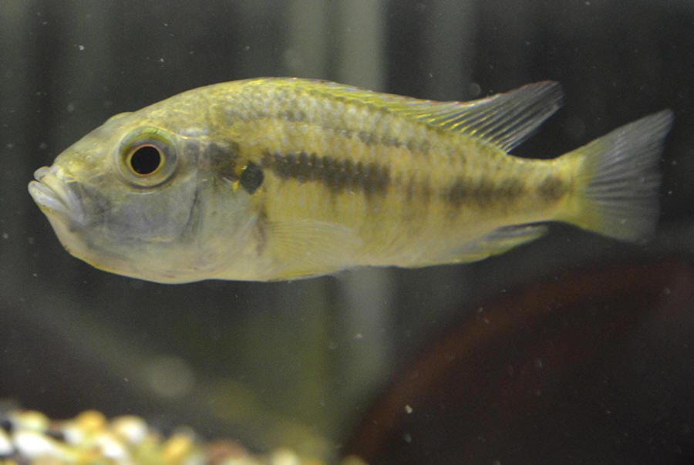
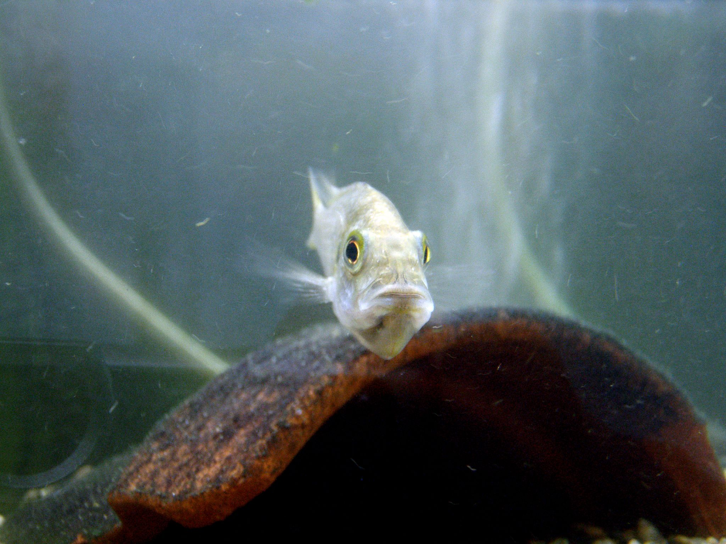
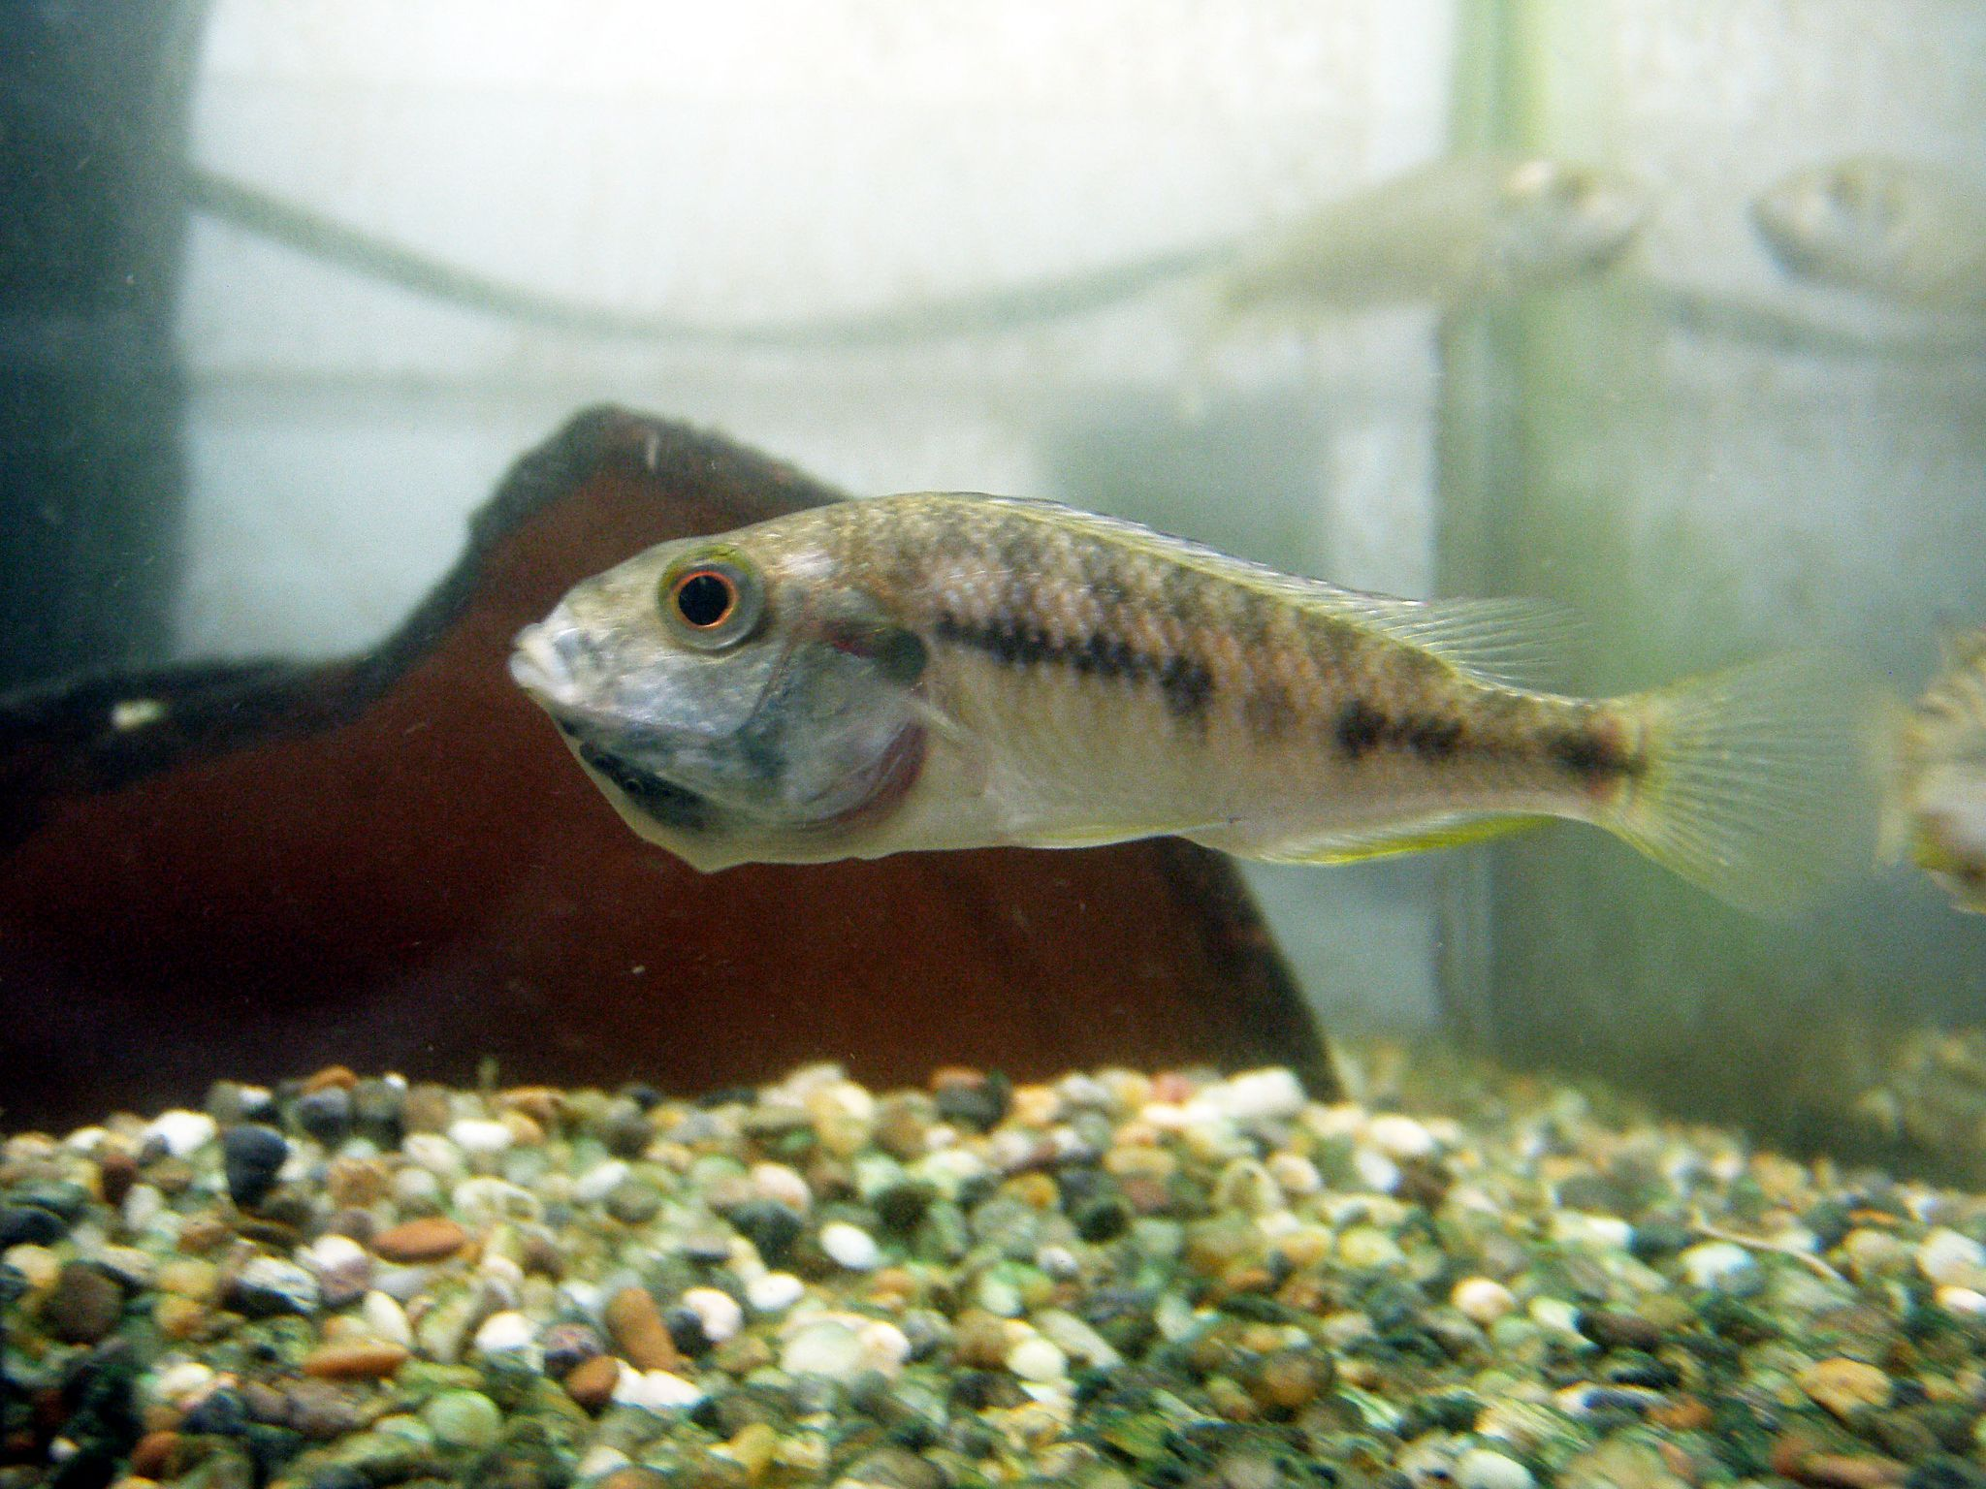
Research Question
What are the sensory and neural mechanisms of parent-offspring recognition during the post-release maternal care phase in A. burtoni?
Maruska Lab
Maruska Lab
Maruska Lab

Slide 5
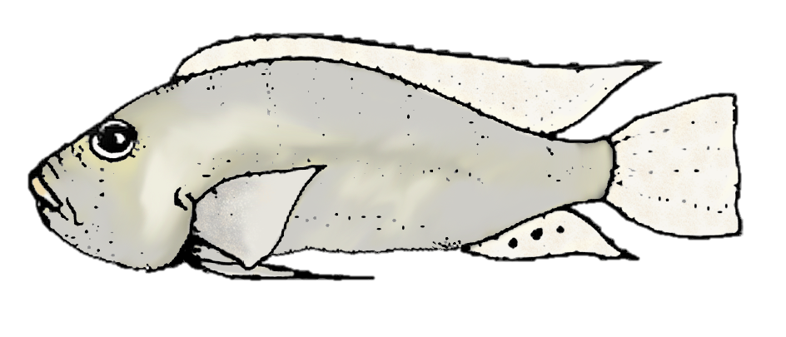

What are the sensory and neural mechanisms of parent-offspring recognition during maternal care?
Chemosensory Stimulus Delivery
Focal Female
Visual Stimuli
Visual stimuli
Chemosensory stimulus
 | Control | Visual only | Chemosensory only | Chemosensory and visual
Notes:
Explain what the actual stimuli are
Make sure to mention I’m doing this for fry too

Slide 6
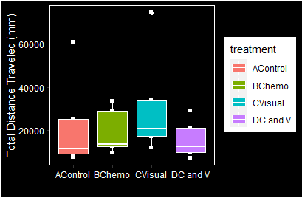
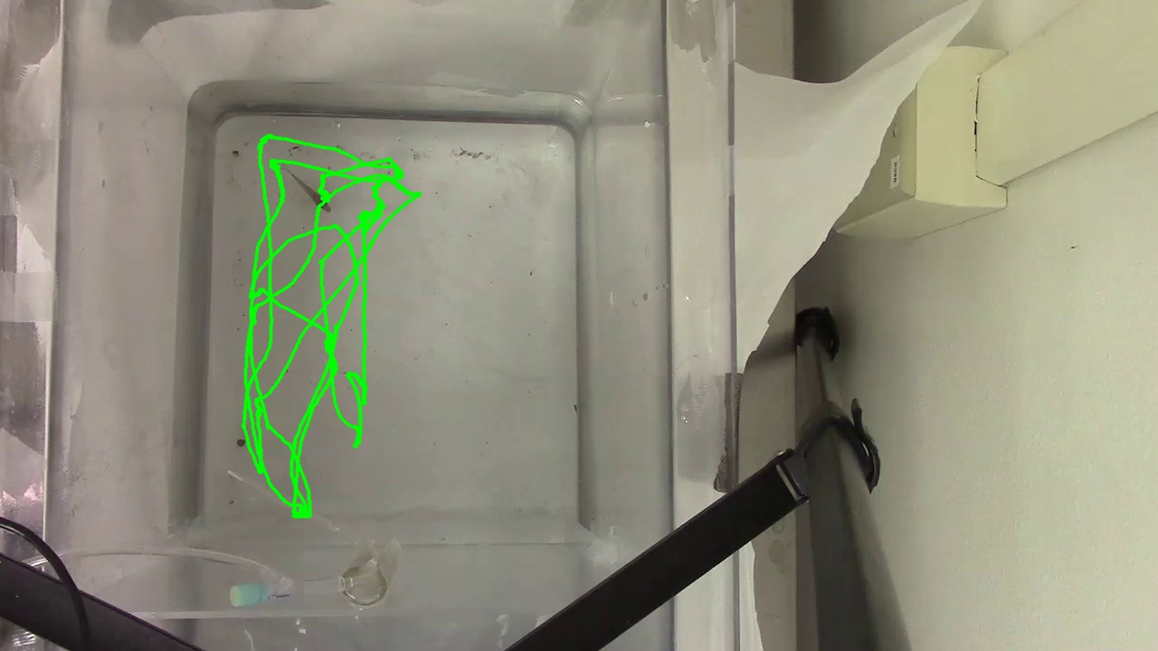
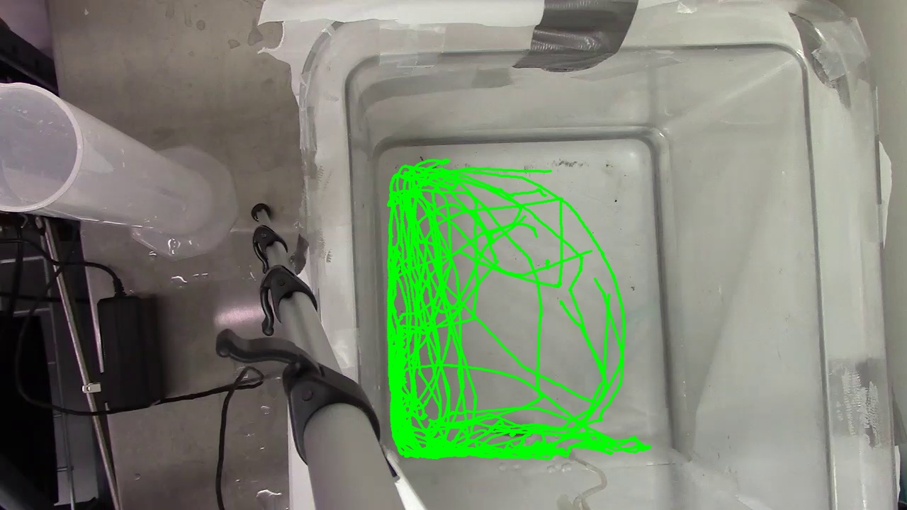
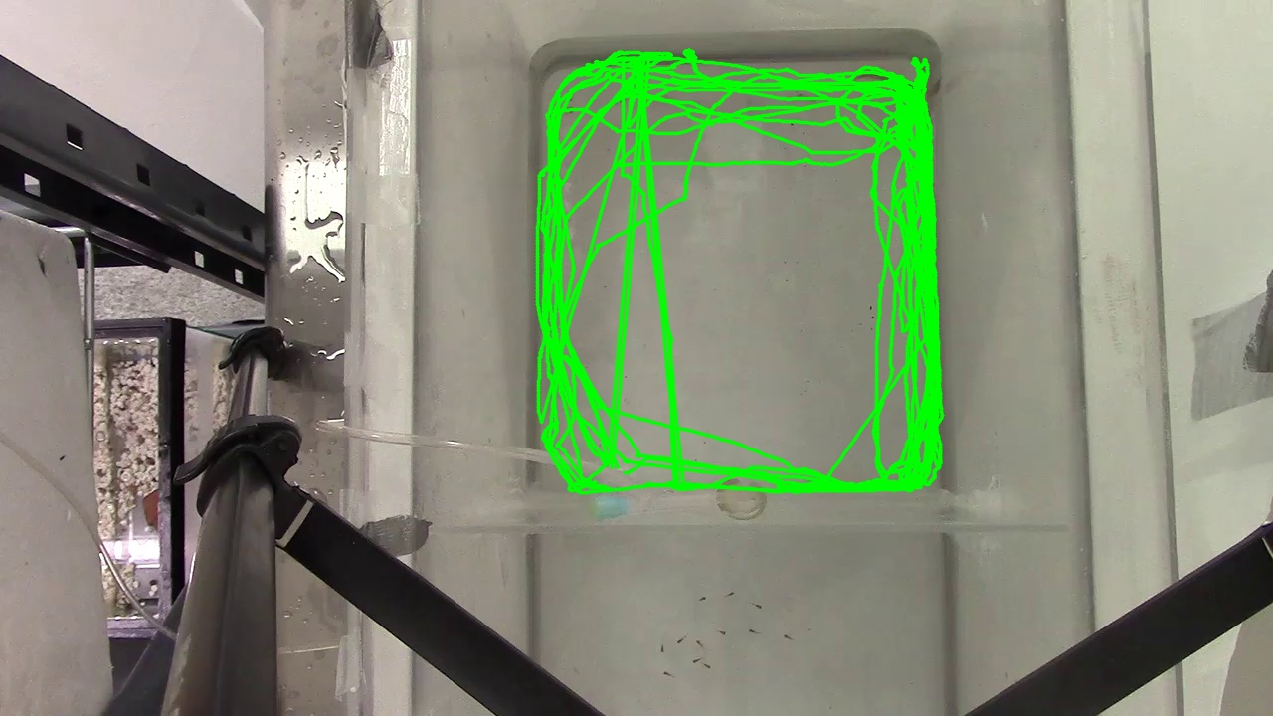
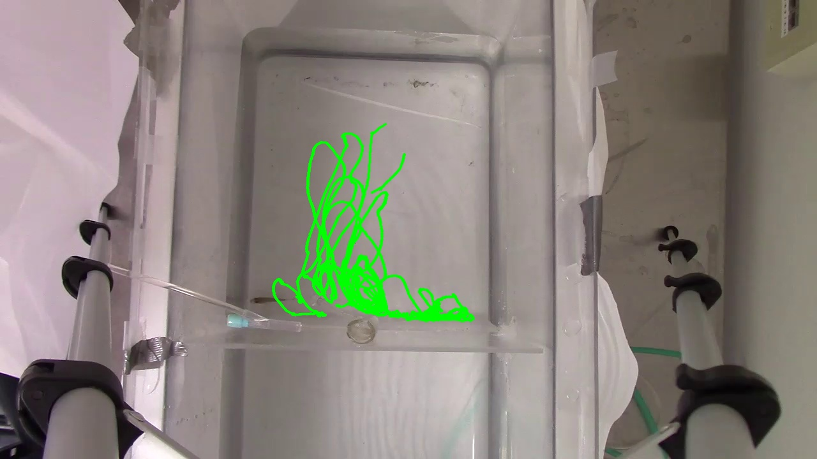
Multimodal fry stimuli may be necessary for offspring identification
Chemosensory Only
Control
n = 5
a
a
a
a
Visual Only
C + V
Visual stimuli
Chemosensory stimulus
Notes:
Switch between gustation and olfaction?
Explain pictures

Slide 7
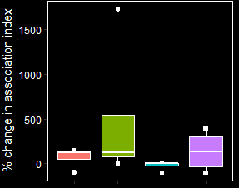
Multimodal fry stimuli may be necessary for offspring identification
n = 5
n = 5
a
a
a
a
a
a
a
a
Visual stimuli
Chemosensory stimulus
Visual stimuli
Chemosensory stimulus
Notes:
Switch between gustation and olfaction?

Slide 8
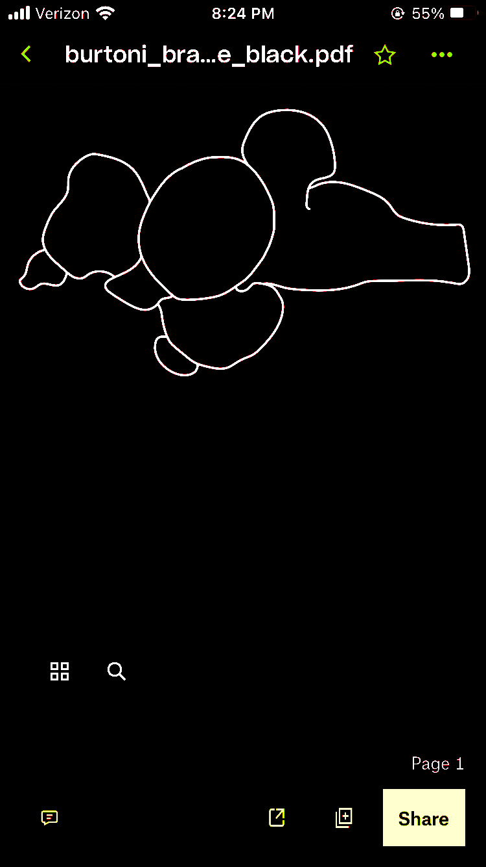
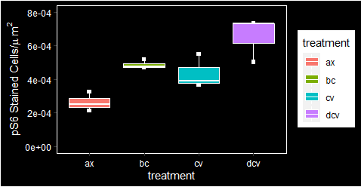
Stimuli from fry result in greater neural activation in the central dorsal telencephalon
b
ab
ab
Dc-5
Dc-5
a
Chemosensory
Visual
n = 3
Visual stimuli
Chemosensory stimulus
Dc-5
Dc-5
Control
C + V

Slide 9
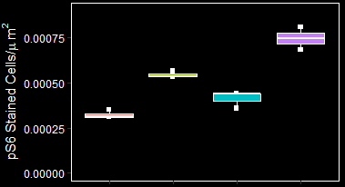
Stimuli from fry result in greater neural activation in the central dorsal telencephalon
b
a
a
a
Dc-4
Dc-4
Chemosensory
Visual
n = 3
Visual stimuli
Chemosensory stimulus
Dc-4
Dc-4
Control
C + V
Notes:
dc = neocortex
Dc stimulation in bluegill results in nest building behavior

Slide 10
Preliminary Results Summary
Maruska Lab
Chemosensory and visual stimuli may both be necessary for parent-offspring recognition in A. burtoni
Different sensory stimuli from fry result in different neural activation patterns in maternal care providing mothers
Maruska Lab
Maruska Lab
Notes:
Non redundant signaling
Will look region by region and will perform PCA/discriminate function analysis to look for networks

Slide 11
Overall Significance
Maruska Lab
Evolution of parental care and offspring recognition
Brain homologies in vertebrates
Cichlids’ response to changing environmental conditions
Maruska Lab
Maruska Lab
Notes:
Fish are the oldest and largest group of vertebrates
Parental care evolved independently several times
Parental care is critical for species persistence
Fish brain homologies hard to determine because fish brains develop by folding outward (eversion) compared to mammals which evaginate

Slide 12
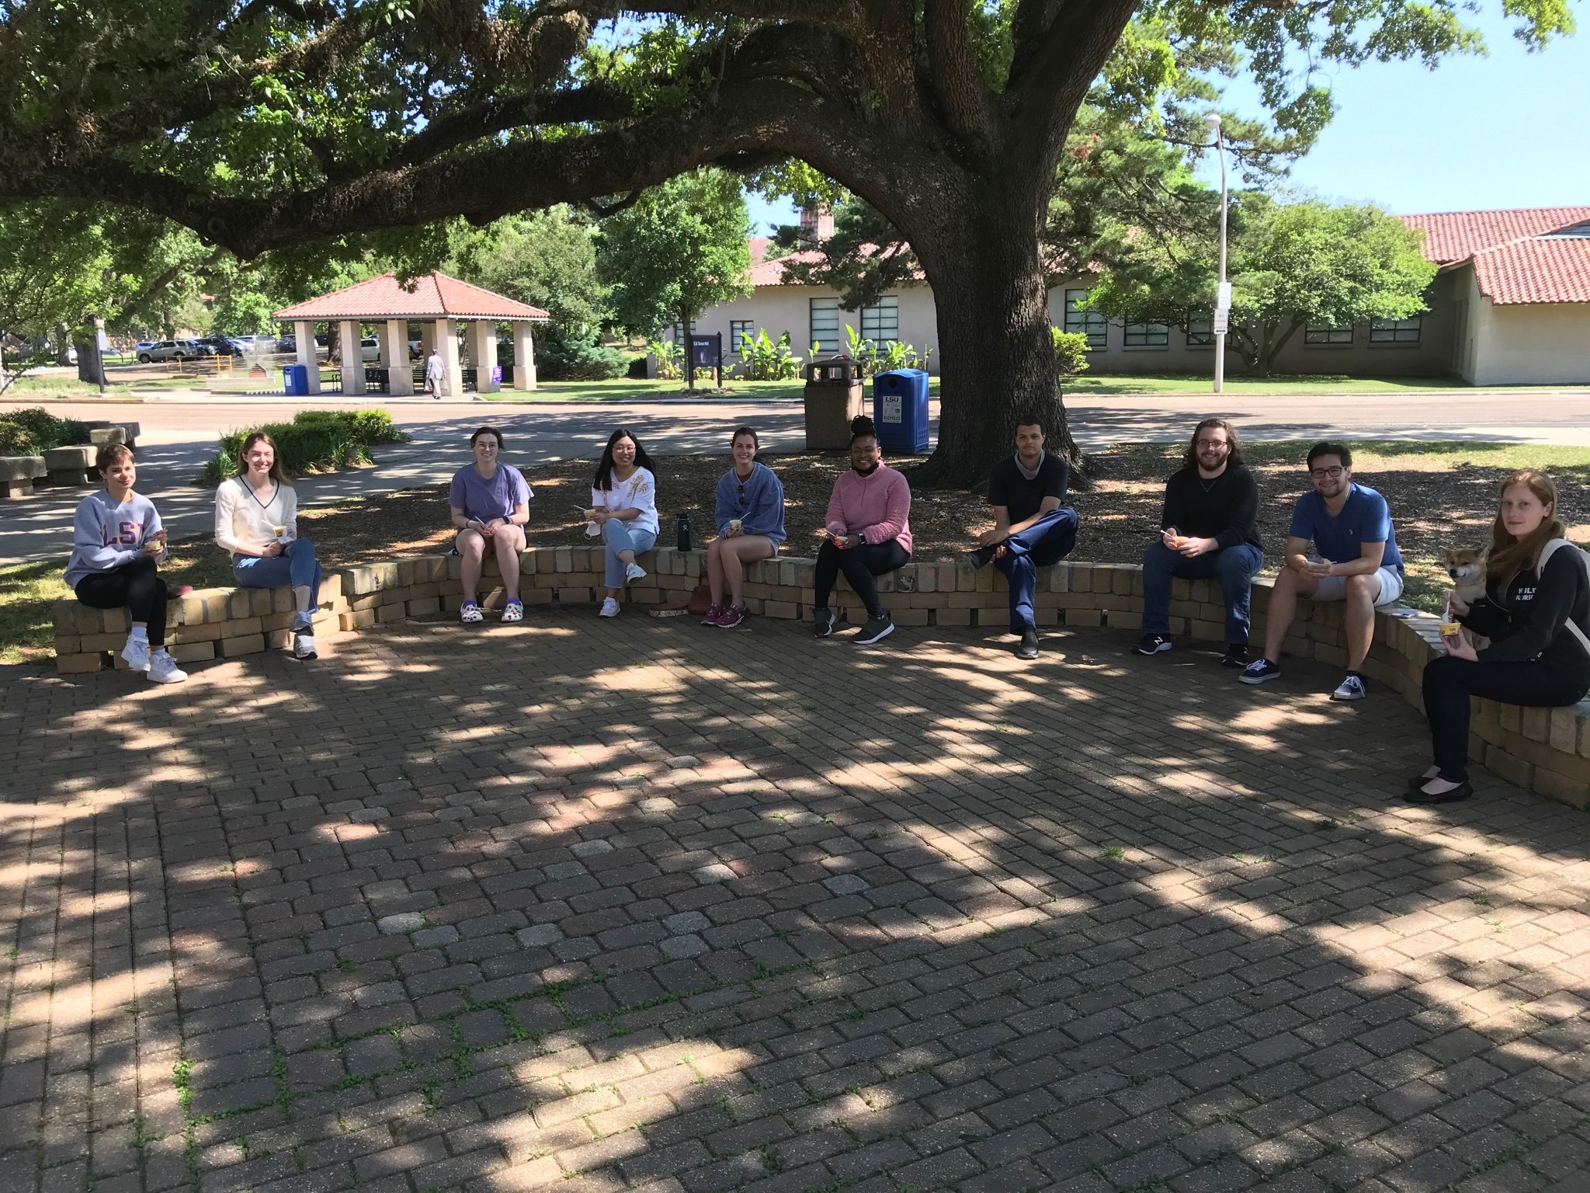

Thank You!
Committee
Dr. Karen Maruska
Dr. Christine Lattin
Dr. Fernando Galvez
Dr. Patricia Schneider
Maruska Lab
Marie Drozda
Hunter Dunn

